Slide 1
CDDIS as an IVS Data Center
Justine Woo
DAAC Scientist
Justine.y.woo@nasa.gov
Colin McLaughlin
VLBI Rep for the CDDIS
Colin.mclaughlin@nasa.gov
Notes:
Crustal Dynamic Data Information System
DAAC = distribution active archive center

Slide 2
Agenda/Table of Contents
What is a Data Center?
How to use the CDDIS Data Center
Special Topics
Data Discoverability
Digital Object Identifiers (DOIs)

Slide 3
What is the CDDIS Data Center?
What is a Data Center?
What is a Data in the context of the International VLBI Service?

Slide 4
What is a Data Center?
General Definition
An entity created to store, manage, and distribute large amounts of data for an organization
International VLBI Service
Notes:
We support two organizations. 1) NASA Earthdata project, 2) International VLBI Service

Slide 5
CDDIS Support for the Earthdata Project
As one of nearly a dozen Earthdata Data Centers, the CDDIS strives to provide continuous public access to the following data and products:

Slide 6
CDDIS Support for the IVS
Goal: provide continuous public access to IVS data and products
2024 CDDIS Downloads for VLBI Files Based on Country Code
Notes:
Repository for VLBI data, products, and related files used to support the creation of data and products
Primary means of distributing VLBI products to users
Works with the Coordinating Center and Analysis Centers to ensure all information and data required by IVS components are quickly and readily available
Distribution

Slide 7
CDDIS Support for the IVS
The CDDIS
Data Centers are imperative for a functional VLBI supply chain
Notes:
CDDIS Supply chain
Of course as a representative from a Data Center, we put ourselves in the middle here. But you can see that if we do not operate as promised, all aspects of the VLBI supply chain are impacted.

Slide 8
CDDIS Support for the IVS - Mirroring
All 3 data Centers strive to perfectly mirror one another.
Within 4 hours
As of 2022, we use common quality control scripts
Notes:
Provide a backup, verification, validations, etc.
You can update to any one data center, and expect that the file will show up on the others within 4 hours.
BKG = Federal Agency for Cartography and Geodesy

Slide 9
How to use the CDDIS Data Center
Uploading to the CDDIS archive
Inside the CDDIS archive.
Downloading from the CDDIS archive

Slide 10
Uploading to CDDIS
1) Create an Earthdata Login: https://urs.earthdata.nasa.gov
Step by step instructions
2) Notify the CDDIS: support-cddis@nasa.gov
3) Upload!
Browser
Curl
java
Notes:
Obtain unique earthdata login to obtain a username
Send us your username and your IP address (wait 2 weeks for firewall approval) LET US know early if you are changing IPs
We provide sample scripts to help you begin uploads, and we are available to help you troublehsoot.
Process may be different for the other DCs, I don’t know

Slide 11
Process Times
Data | Processing
SWIN | Hourly
All other uploaded files | 2x per hour
Downloads from other DCs (Mirror) | Every 4 hours
Quality Control
File Ingest
upload
Archive
download
Notes:
Uploads sit in our basin machine (storage tank if you will). We run cron jobs which process the files at regular intervals.
SWIN = data format output by the DiFX software correlator, which was developed at Swinburne University of Technology.
DiFX = Distributed FX

Slide 12
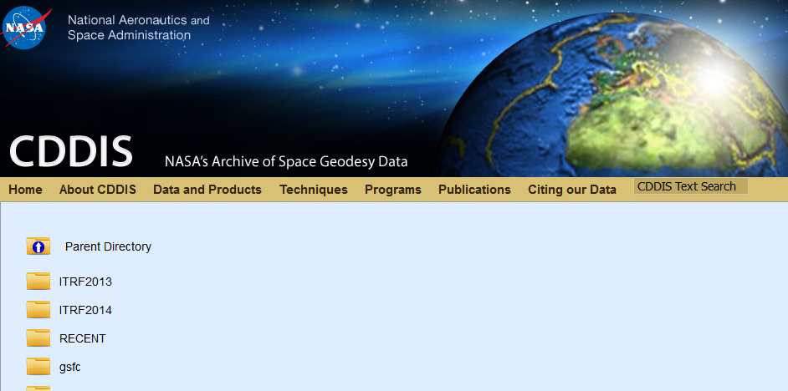
View Online
Files will be visible on our webpage with checksums
Notes:
Once uploaded, we will index your files to create so that they are visible on our webpage, along with checkums.

Slide 13
Download via Script
Notes:
Provide samples scripts for downloading files.
Useful for automation or bulk downloading.
We are available to help troubleshoot
You need earthdata login to be able to do this

Slide 14
Special Topics:
Data/Product Discovery. Landing Pages. DOIs.

Slide 15
Earthdata Website
Data and products available on Earthdata Website where users can search for data/products across the NASA DAACs
Support metadata search
Data and products are explained on landing pages and DOIs available
Notes:
I mentioned that we serve the Earthdata project and the IVS.
At earthdata we support VLBI and many other data types, but lots of data types exist in earthdata project
TO this end, the earthdata project is created a common webpage:
Instead of directory structure search, we will not use a search bar.
Some people will like this, others not so much. We will do what we can with DOIs and landing pages.

Slide 16
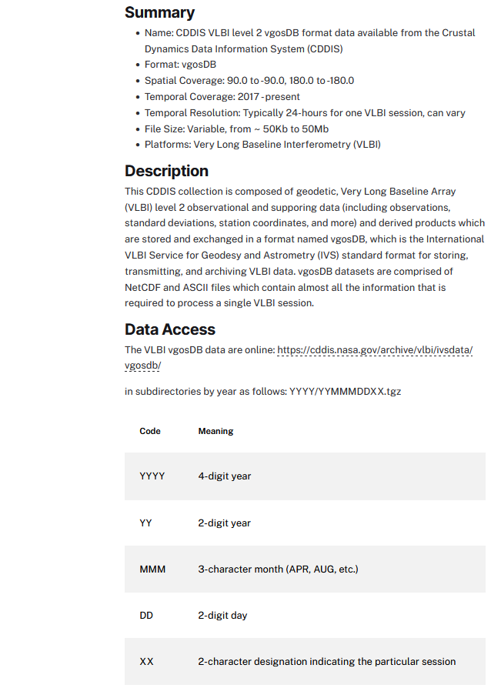
What are Landing Pages?
Landing pages contain:
Summary
Link to location in the online archive
Link to additional resources
Digital Object Identifiers: DOIs
Works best as an introduction to new users
Notes:
Good news is: We will continue to provide landing pages.
Landing page is first page of instruction manual.
Summary with basic info
Link to archive
Additional resources, usually from the IVS

Slide 17
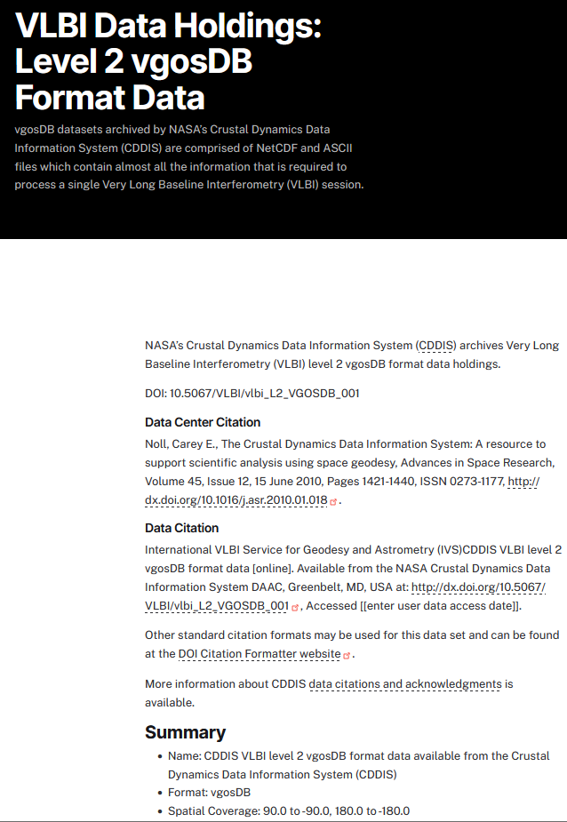
Data and Product DOIs
Allow data, products, software to be cited
Benefits:
Increased visibility
Increased verification and validation of scientific results
Ensures credit can be traced down to the station level
Are stations/correlators getting credit? - Not yet…
Notes:
A DOI is a Universal source or unique identifier to cite the same thing
Right now, we just site ourselves (landing pages) want to make sure other parts of the VLBI supply chain are getting credit for the work they do.
Open conversation, should stations, correlators make and publish their own DOIs, or should we do it for them?
Important Note: DOIs are available for some data and products and the CDDIS will be working on filling in the missing DOIs

Slide 18
Thank You! Any Questions?
General questions to the CDDIS:
gsfc-cddis-support@mail.nasa.gov

Slide 19
Sample Landing Page
Notes:
Good news is we will continue to provide landing pages.
Probably deltet this slide and combine with the next slide.

