Slide 1
VLBI Communications Center (VCC)
Gönenç Moğol
Mario Bérubé
TOW 2025

Slide 2
Agenda
Current method of communication
VLBI Communications Center (VCC)
VCC - Status
VCC - DEMO

Slide 3
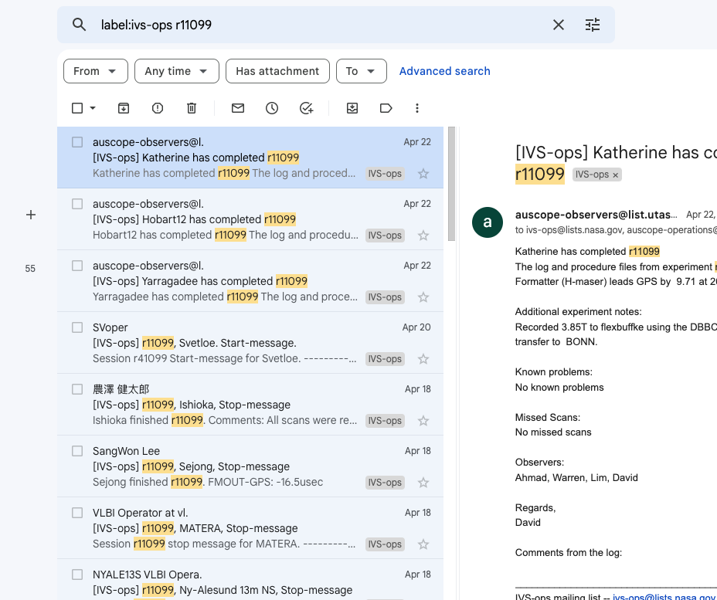
Current method
Emails (IVS mail exploders)
Need human to extract information
Unknown if message reach target audience
Limited automation
Data archiving system and web pages
Synchronization issues
Low traceability
Limited automation
Notes:
After describing the email, you can click to show a typical email.
Emails used to be “standardized” but now each station has its own format.
There is a system to filter emails but it misses few emails each month because of missing information or typo
Regarding 7 days. We tried few times to send new schedules when problems were detected but in many cases, stations were running with different schedules.

Slide 4
Current method
VCC

Slide 5
VLBI Communications Center (VCC)
Machine-to-machine data exchange
Fully automated
Near real-time two-way communication
Traceability of data/information exchange
Secure
Notes:
General information: sessions, stations, SEFD and more.

Slide 6
VCC Database
Latest information
Sessions
Station Catalog
Station availability (Downtime)
Events
Submitted/retrieved files
Specific messages
User credentials i.e. access roles
Accessed using the Web Service

Slide 7
VCC Web Service
Used to access the database
Data exchange using JSON structured messages
Validation and Encryption
Each user is assigned a key
Generates internal “signals”

Slide 8
VCC Message broker
Messages generated by signals or external users
Near real-time two-way communication
Dispatches messages using specific rules
Only specific users are contacted
Does NOT control any hardware
Messages stored in the “queue” of each user (inbox)
Analogy: Old-school pigeonhole mailboxes

Slide 9
VCC Authentication& Security
Each user is assigned a key
Messages are encrypted and signed
Users are assigned access roles
Network Station
Coordinating Center
Analysis Center
Correlator
Messages are validated by the web service

Slide 10
Updating session
USERS download data for session
Coordinating Center uploads session
VCC informs specific USERS

Slide 11
Uploading schedule
Operations Center generate schedule
Operations Center upload schedule
STATIONS download schedule
VCC informs specific USERS
VCC informs Operations Center

Slide 12
Observation
Dashboards display ONOFF data
STATION prepares session
(pointing)
STATION uploads ONOFF data
STATION running schedule
STATION upload log file
Messages
(ready start halt continue problem stop)
ONOFF
LOG
VCC informs Dashboards

Slide 13
Status
Linux (Ubuntu) server on the cloud
Client applications
Python (3.9 or higher) package
Linux, MacOS, Windows (WSL), FS
MariaDB
Python (FastAPI)
Data exchange using JSON
RabbitMQ
Defined specific message structure
Defined dispatching rules
Accessible via https or ssh tunnel

Slide 14
Configuring VCC

Slide 15
USE CASE: Network Stations
vccmon monitoring Inbox and FS logs.
could be started manually or using systemctl service
Should run in the background
vccns {action}
drudg {session}: Run drudg on schedule for specified session
onoff {path_to_log}: Extract onoff values from log and upload to VCC
log {session}: Upload log for specified session.
skd|vex|prc {session}: Retrieve skd, vex or prc files for specific session.
No action will display upcoming sessions for your station
inbox {code} Monitor inbox for specified group
downtime inform IVS that station could be down for specific period
urgent Inform IVS of any urgent issues
dashboard {session} Run dashboard for specified session

Slide 16
Other TOOLS
vcc {None|int|std} {Station code}
List upcoming sessions (all, intensive or standard 24H)
vcc sked {skd} {vex} {txt}
Upload schedule files skd, vex and txt. Only executed by Operations Center (OC)
master {session|master}
Used by Coordinating Center (CC) to update master schedule
downtime {station}
Used by CC to inform downtime for station

Slide 17
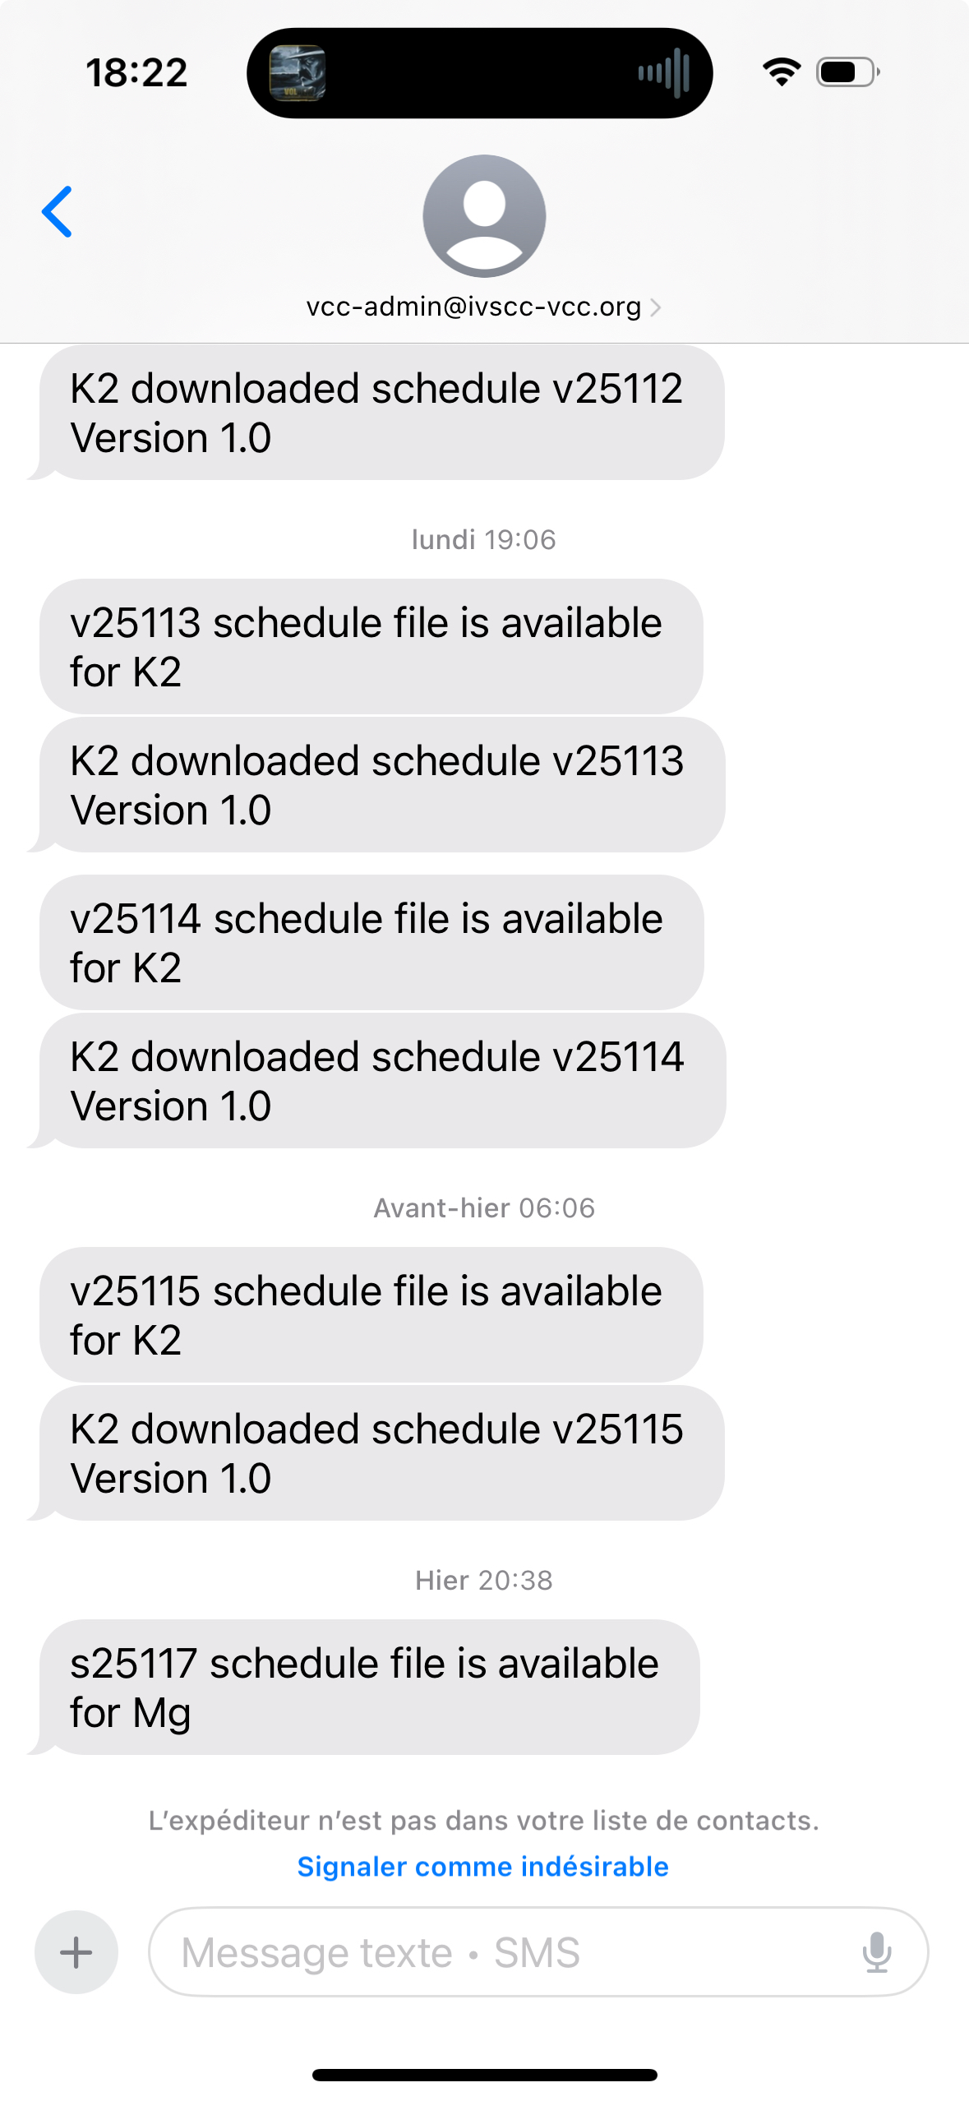
VCC - Friend
Anybody can request that messages sent to a specific IVS component could be sent to their email or cell phone.
somebody@email.com
1234567890@provider.com
Send request to
gonenc.mogol@nviinc.com
mario.berube@nviinc.com
Notes:
This is a feature that was requested by Darryl Lakins. He his receiving messages regarding NASA VGOS stations.
This could be setup for any IVS components.
The K2 station is not the NASA K2 at Kokee but the one running on atri3.

Slide 18
VCC– DEMO

