Slide 1


Snow Depth Retrieval on Polar Sea Ice
By Soumil Mukherjee
Mentors: Dhiman Mondal, Pedro Elosegui, Chet Ruszczyk, John Barrett, Dan Hoak, Russ McWhirter

Slide 2
Outline
Importance of sea ice and snow
Traditional techniques to measure snow depth on sea ice
Traditional method to retrieve snow depth using GNSS-REFL software for a signal reflector
Experiment with synthetic data for two reflectors
Result from the real data
Summary and challenges
Future work

Slide 3
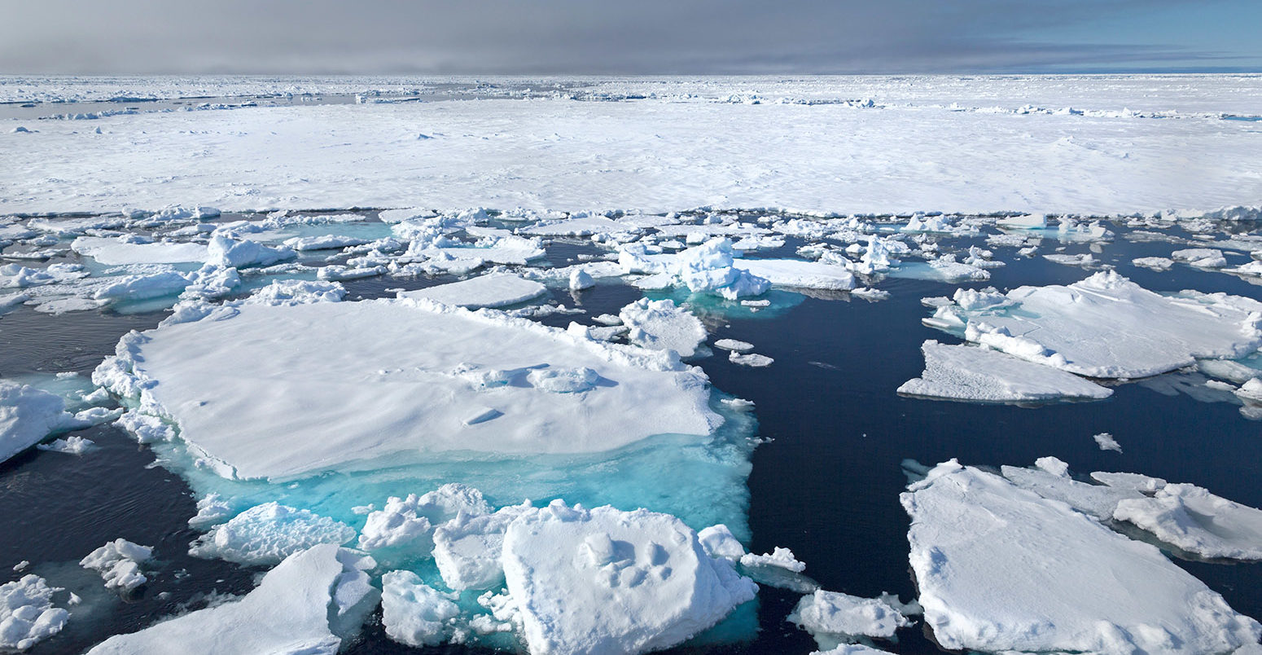
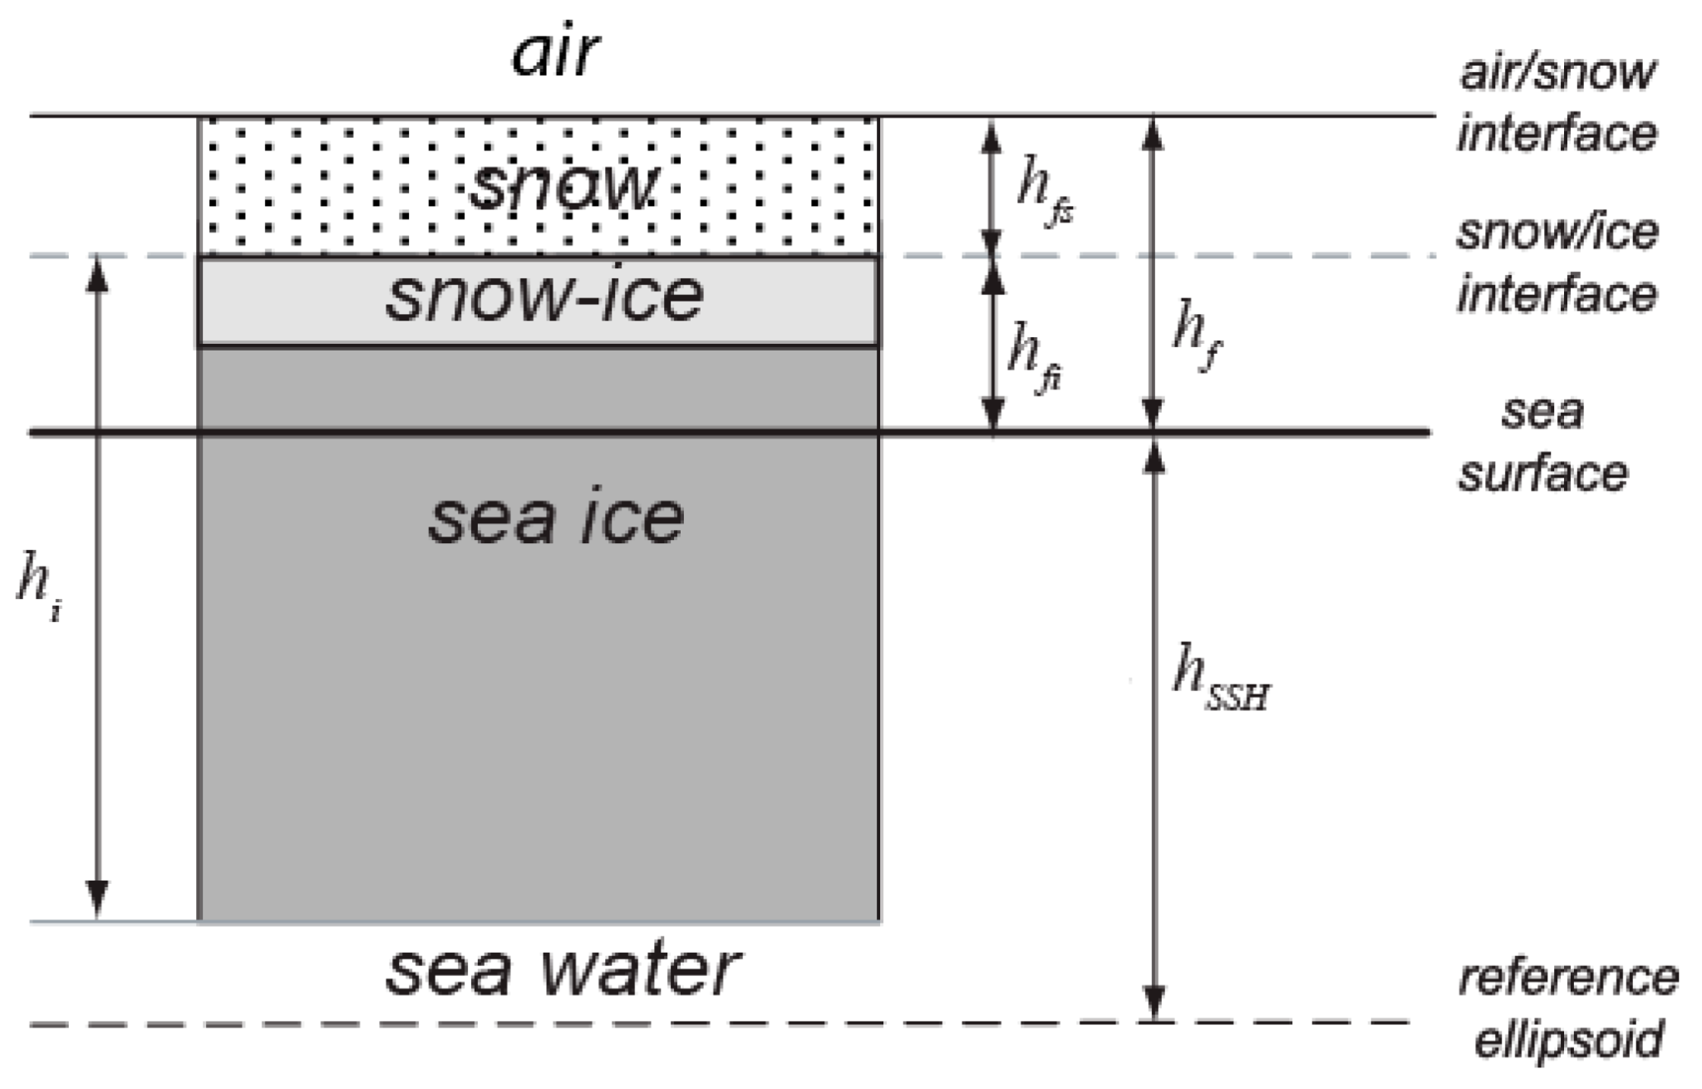
Importance of Arctic snow over sea ice
https://www.carbonbrief.org/arctic-sea-ice-winter-peak-in-2022-is-10th-lowest-on-record/
[Modified after Kacimi et al., 2024]
Snow acts as a blanket that protects sea ice from solar radiation
Snow plays a vital role in the sea ice thickness estimation

Slide 4
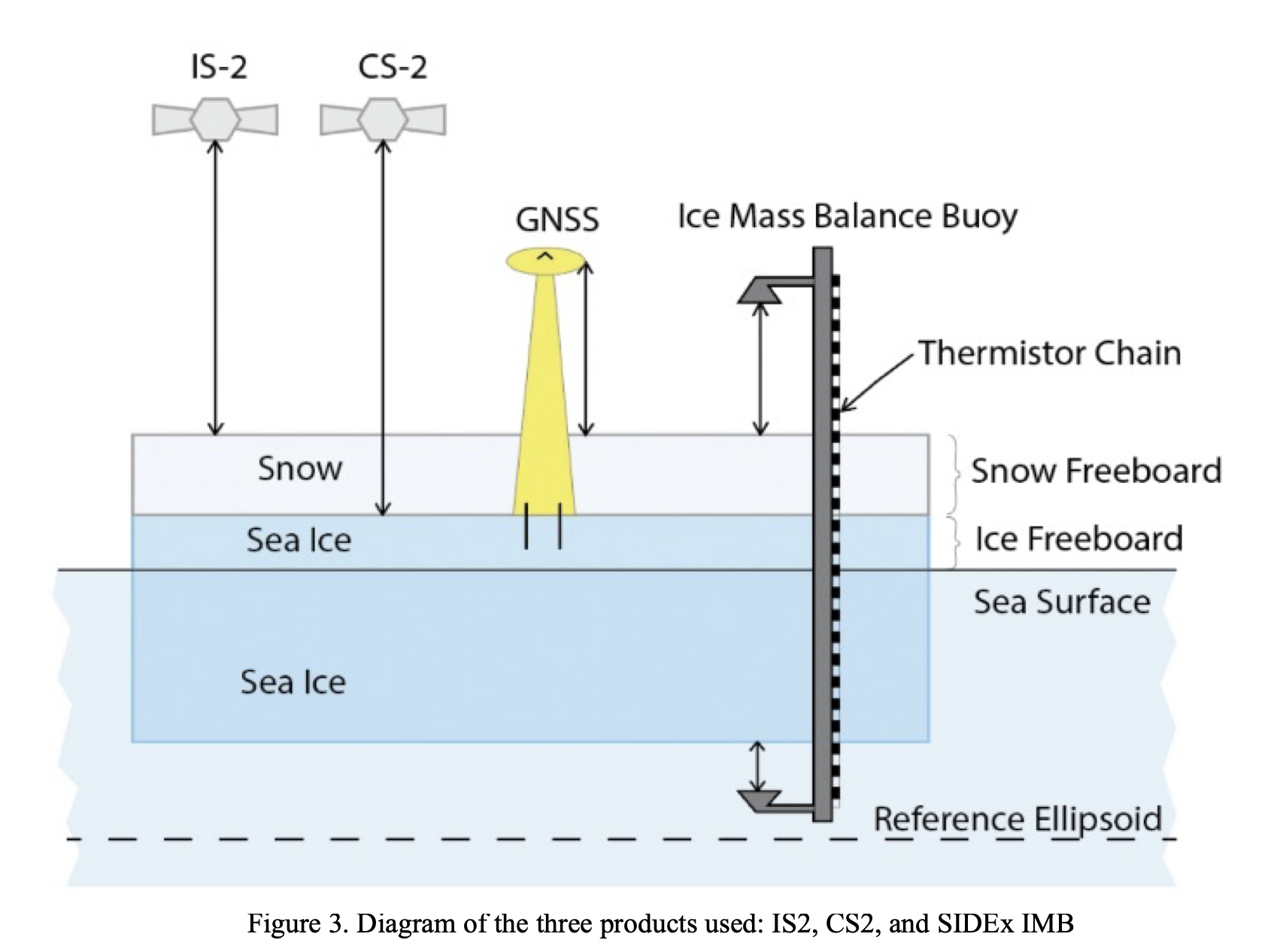
Techniques used to measure snow thickness
Snow thickness can be estimated from the difference of ICESat-2 and CryoSat-2 freeboard.
It can also be measured using Magnaprobe.
[Modified after Benedict et al., 2024]

Slide 5
Snow depth from GNSS
If feasible, snow depth can be estimated using SIDEx GNSS array of 12 stations deployed in Arctic in 2021.
The estimates can be validated using the direct snow-depth measurements from Ice Mass Balance Buoy.
[Modified after Benedict et al., 2024]

Slide 6

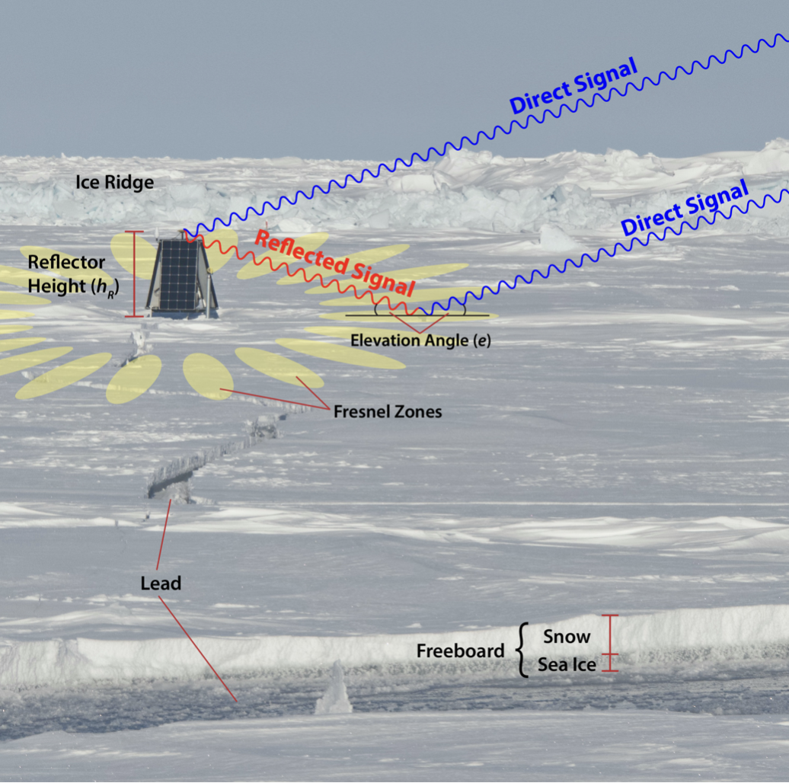
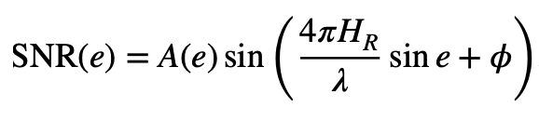
How Do We Measure Reflector Height and Snow Depth?
https://github.com/kristinemlarson/gnssrefl
https://gnssrefl.readthedocs.io/en/1.3.13/pages/understand.html

Slide 7
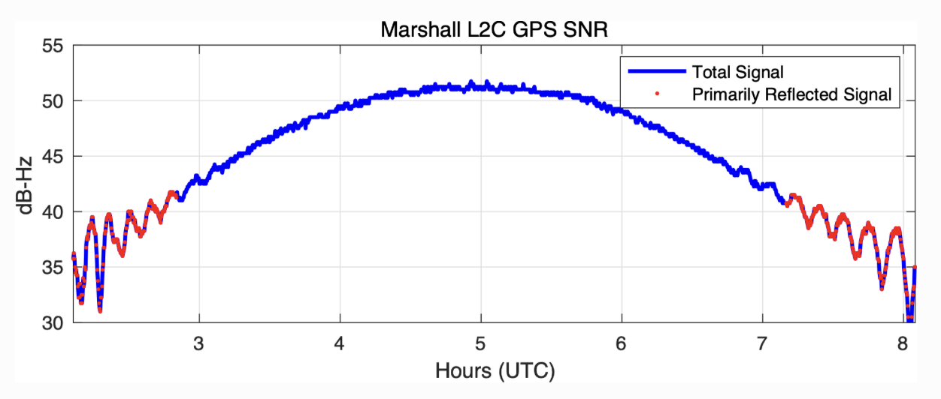
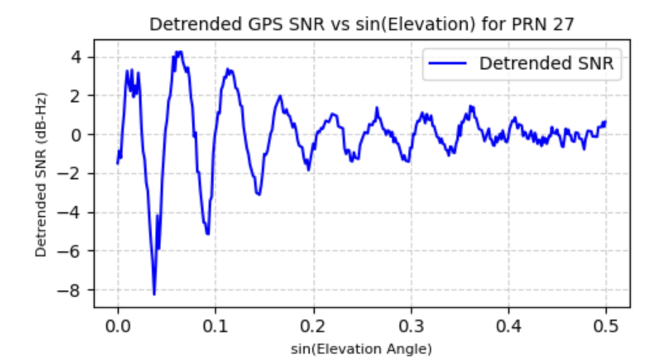
SNR from a single satellite
Detrended SNR pattern can provide information about one reflector height
Objective
Obtaining snow depth using two-reflector model
https://gnssrefl.readthedocs.io/en/1.3.13/pages/understand.html

Slide 8
Methods
We will utilize 3 differents methods
Grid Search Method (GSM)
Fast Fourier Transforms (FFT)
Lomb-Scargle Periodograms (LSP)
Well known software GNSS-REFL uses LSP but for single reflector
We demonstrate the efficiency of three different methods first with synthetic data and then with real observations

Slide 9
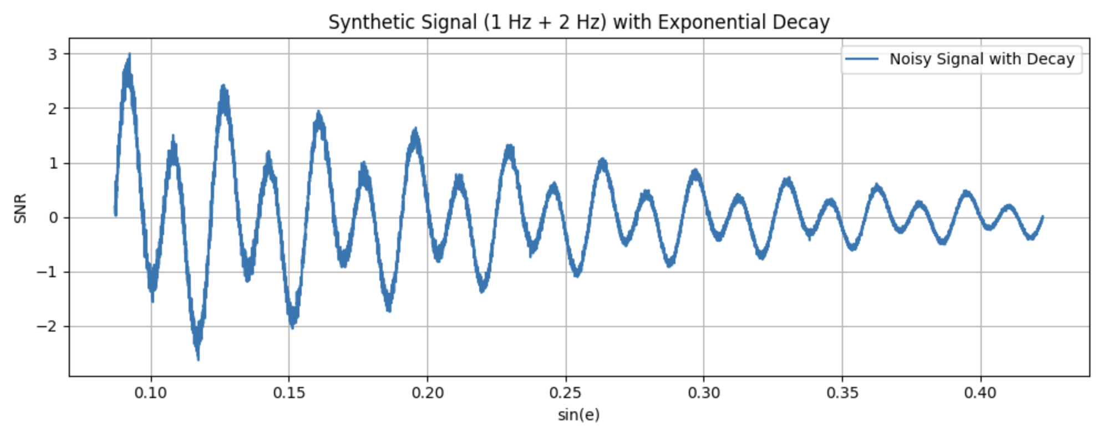
Synthetic signal with known reflectors height
Generated a synthetic signal for 1m and 2m reflector height using the SNR equation with some noise
Recovered the reflector height using three different methods.

Slide 10
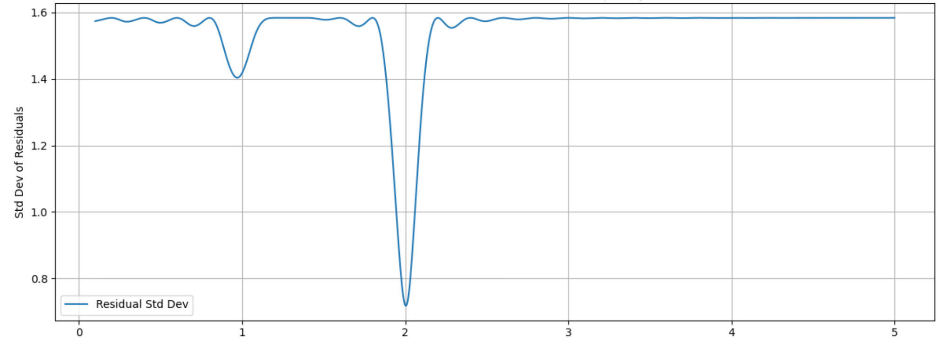
Results: Reflector height retrieval using GSM
Reflector Height H_{R} (m)
Generated signal for H_{R} 0.5 to 3 and A between 1 to 5
Calculated Misfit function = mean square error(Synthetic_SNR − Generated_SNR)
The best fit was found by minimizing residual misfit across the grid around 1 and 2m

Slide 11
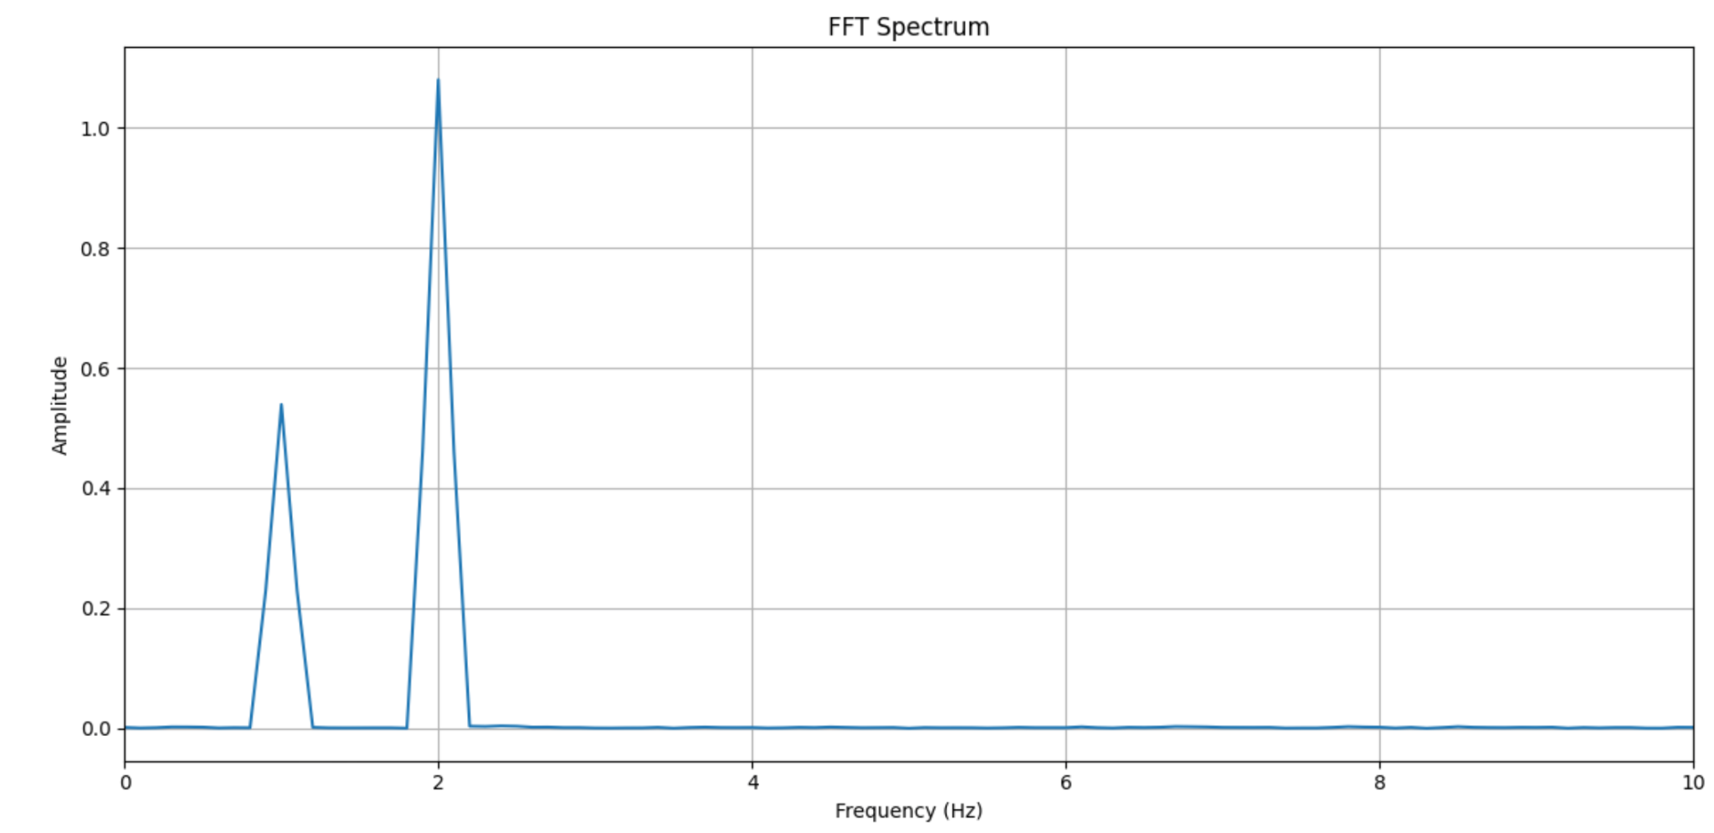
Results: Reflector height retrieval using FFT
Reflector Height H_{R} (m)
FFT method also captured two peaks around 1 and 2m

Slide 12
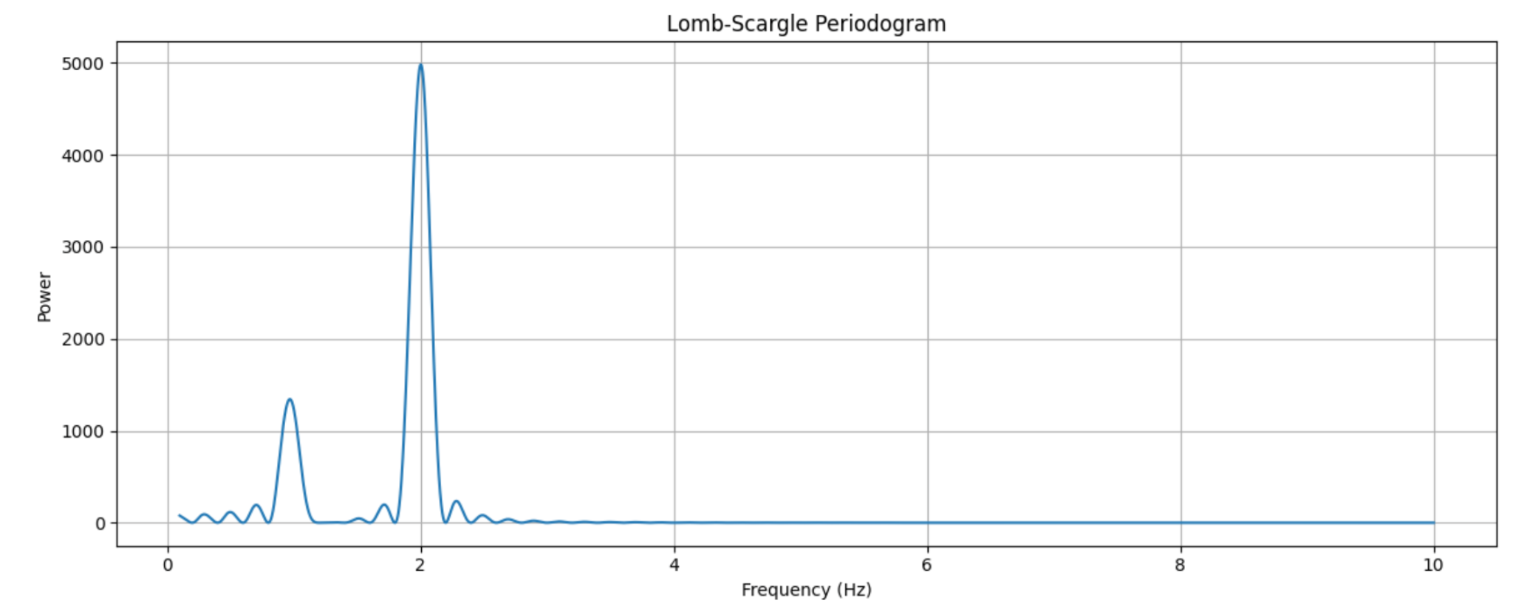
Results: Reflector height retrieval using LSP
Reflector Height H_{R} (m)
LSP is commonly used in GNSS-REFL software
LSP also retrieved two peaks around 1m and 2m

Slide 13
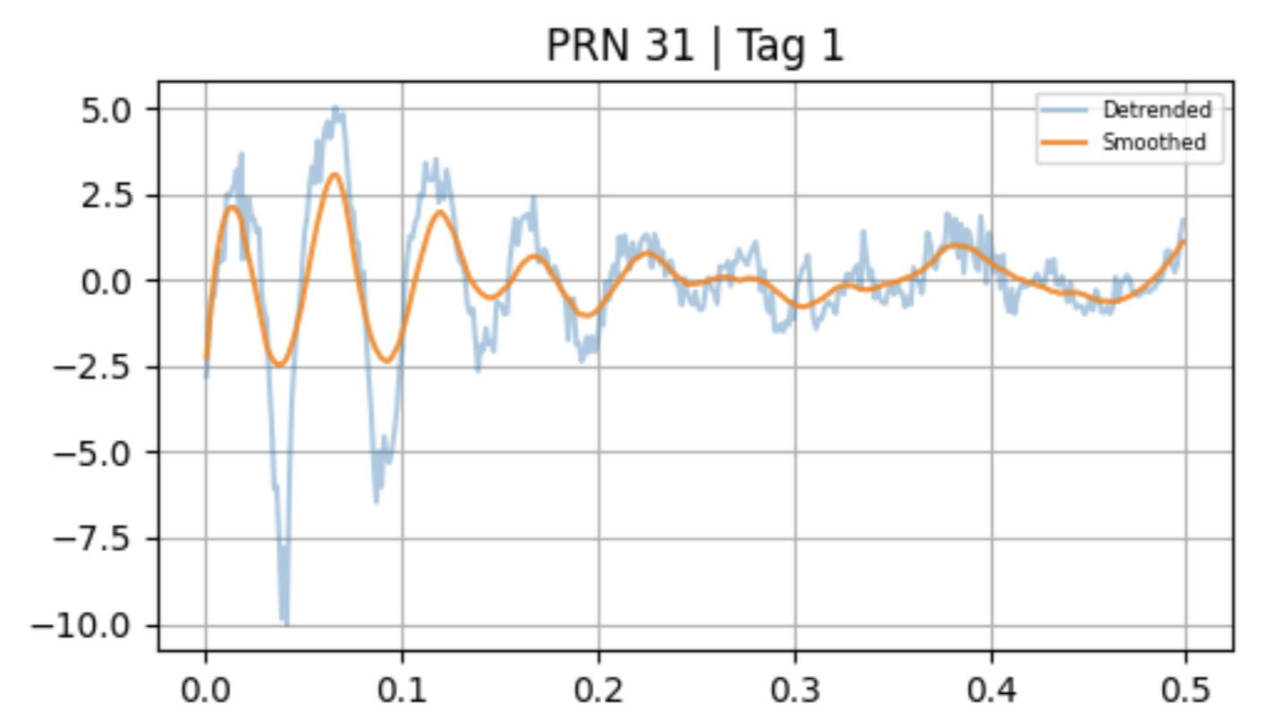
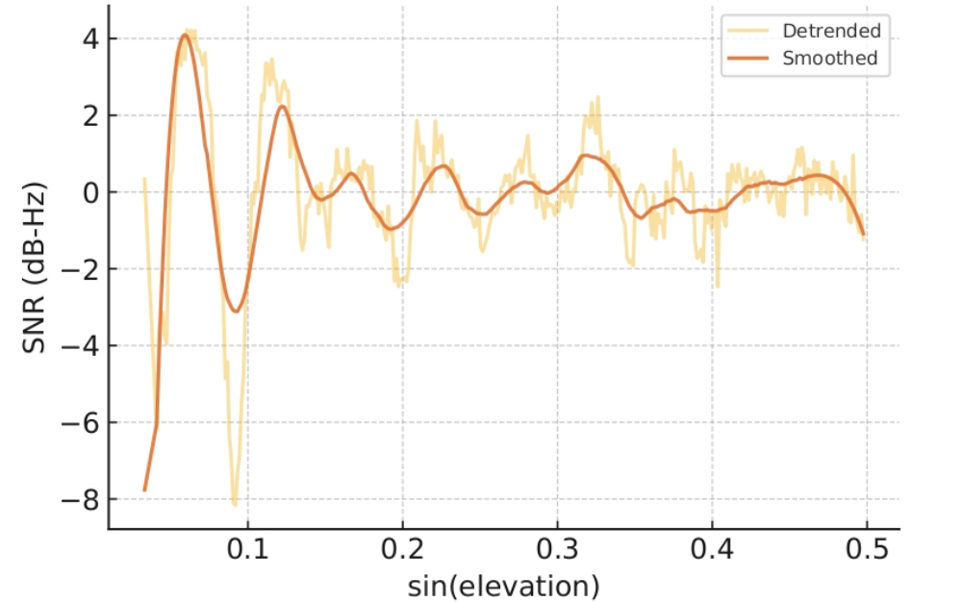
Result: From Real data
Other methods failed to retrieve both surfaces
Only method that worked on real data
Achieved uncertainties within one centimeter

Slide 14
Summary and challenges
Demonstrated that synthetic two-reflector signals can be reliably decoded
Standard methods (FFT, LSP, Grid Search) work on synthetic data but fail on real SNR signals
Only the Wang 2022 method successfully retrieved both reflector heights from real data
Visual inspection shows variable signal quality—some segments exhibit clear periodicity, others are noisy and ambiguous
Identifying snow depth in the presence of multipath and noise remains challenging
No existing tools robustly handle multi-reflector real-world data

Slide 15
Future work
Build tools that can separate multiple reflectors—possibly using signal decomposition or a multi-cosine fit.
Replace fixed-window detrending with adaptive filtering that responds to signal features, not just assumptions.
Create a residual classifier: something that flags when a fit is likely invalid based on structure in the residuals.
Use ML to classify signal types: Is this a clean single reflector? Multipath? Unreliable?

Slide 16
Acknowledgement and references
I would like to sincerely thank my mentors—Dhiman Mondal, Chet Ruszczyk, Pedro Elosegui, Scott Paine, John Barrett, Dan Hoak, and Russ McWhirter—for their guidance and support throughout this project. I am also grateful to the Haystack Observatory IT staff and the REU program coordinators for making this experience possible. This research was supported by the National Science Foundation (NSF) through the Research Experience for Undergraduates (REU) program at MIT Haystack Observatory, under award number 2243909.
References:
Kacimi, S., & Kwok, R. Arctic Snow Depth, Ice Thickness, and Volume From ICESat-2 and CryoSat-2 Freeboards. Journal of Geophysical Research: Oceans, 2022.
Daneghian, S., et al. Retrieving Snow Depth on Sea Ice Using Satellite Observations and Deep Learning. 2024.
McSweeney, Robert. "Arctic sea ice winter peak in 2022 is 10th lowest on record." Carbon Brief (2022). Retrieved from: https://www.carbonbrief.org/arctic-sea-ice-winter-peak-in-2022-is-10th-lowest-on-record/
Larson, Kristine M. "GNSS-IR Software: gnssrefl." GitHub Repository (2023). Retrieved from: https://github.com/kristinemlarson/gnssrefl
Larson, Kristine M. "Understanding GNSS-IR: Reflectometry Principles." gnssrefl Documentation (v1.3.13). Retrieved from: https://gnssrefl.readthedocs.io/en/1.3.13/pages/understand.html

Slide 17
Questions?

