Slide 1

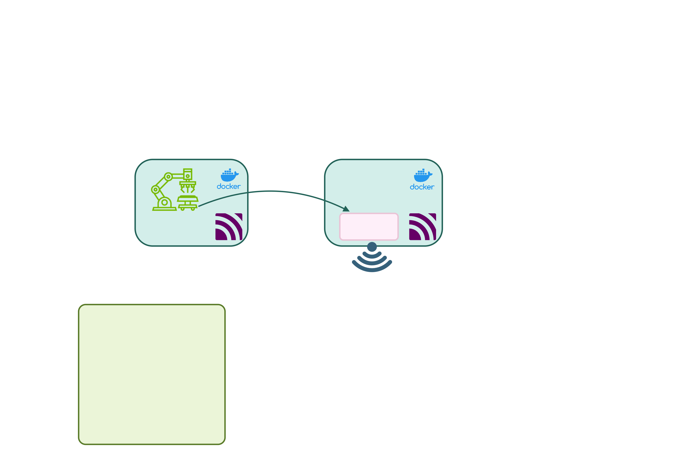
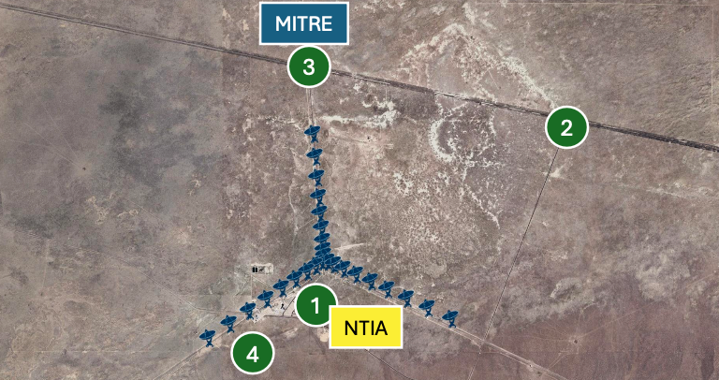
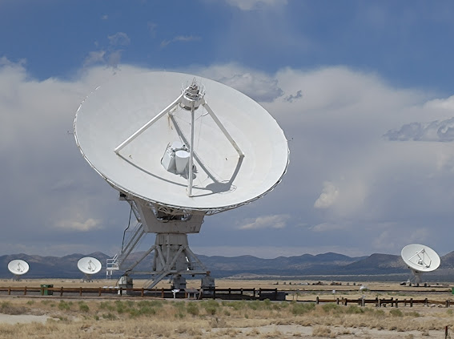
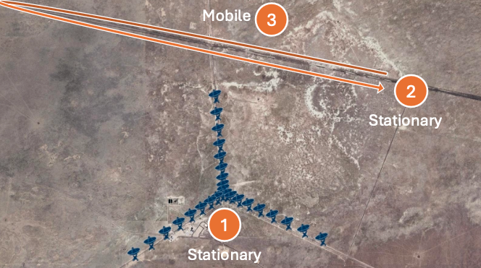
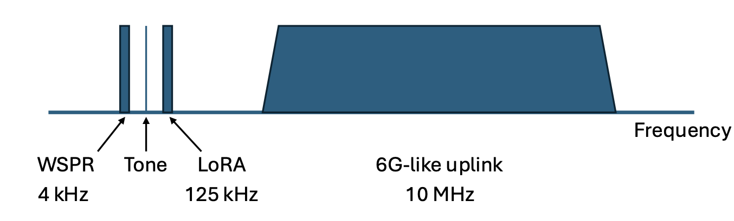
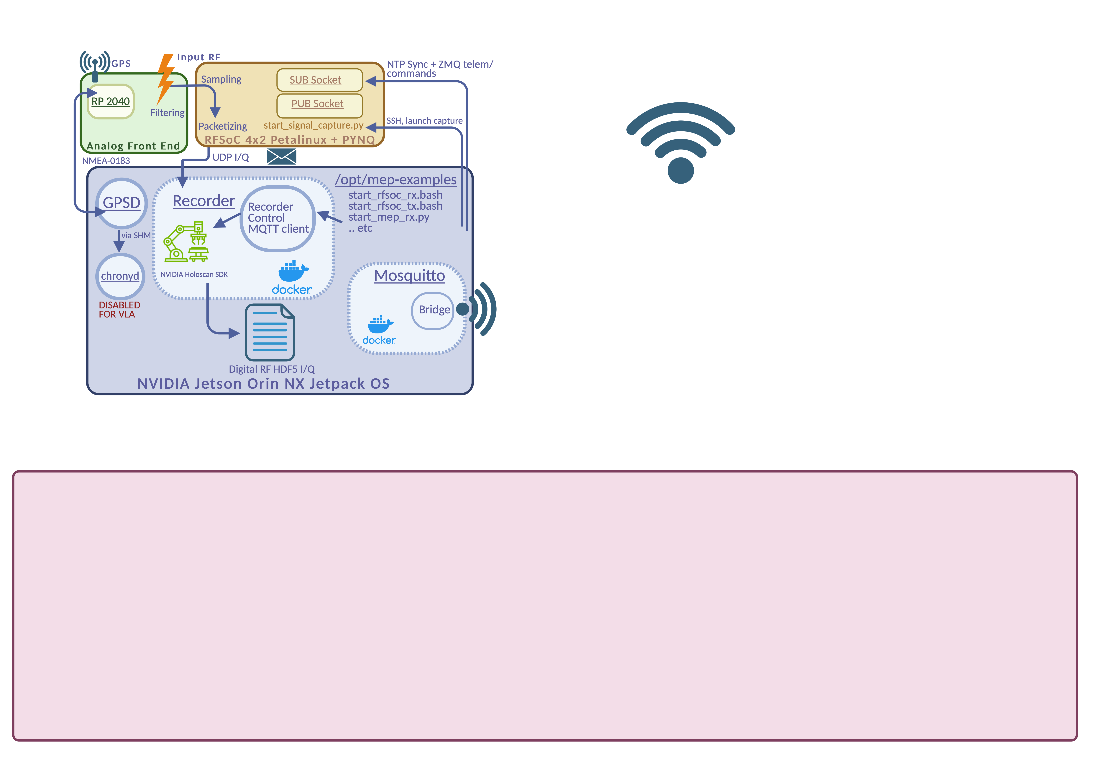
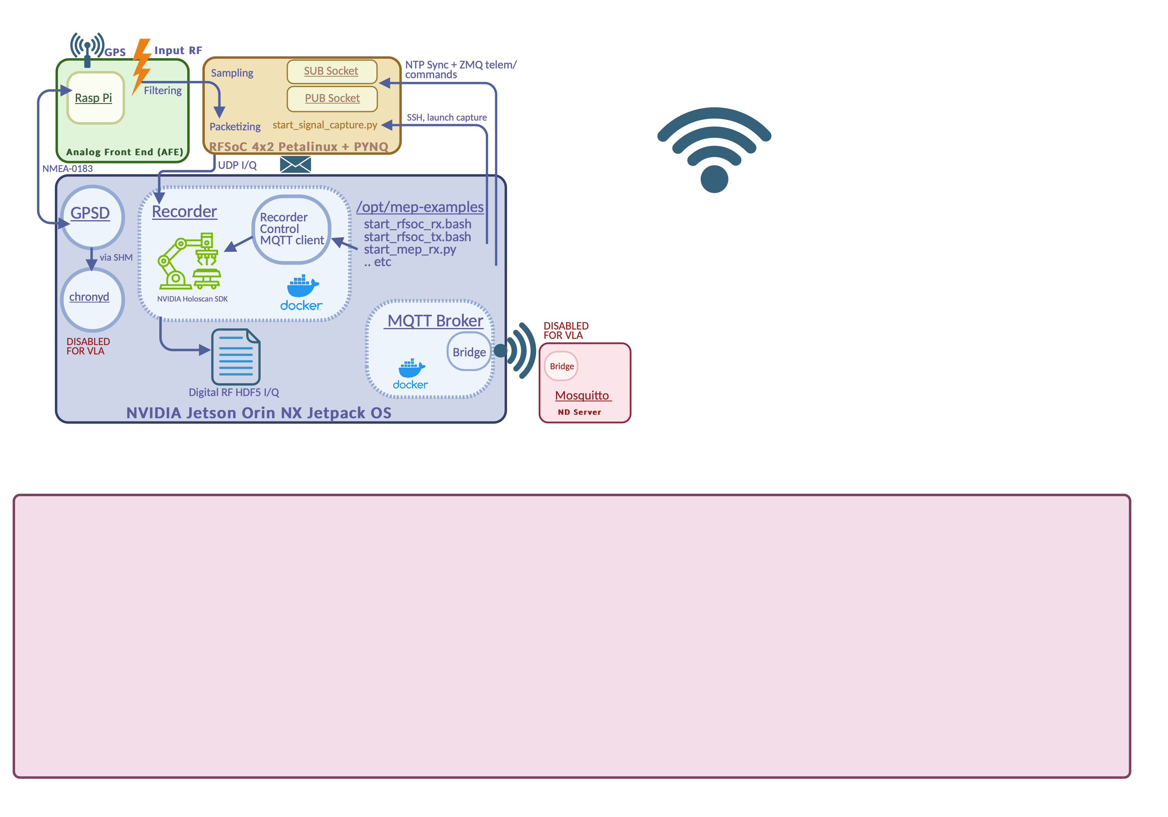
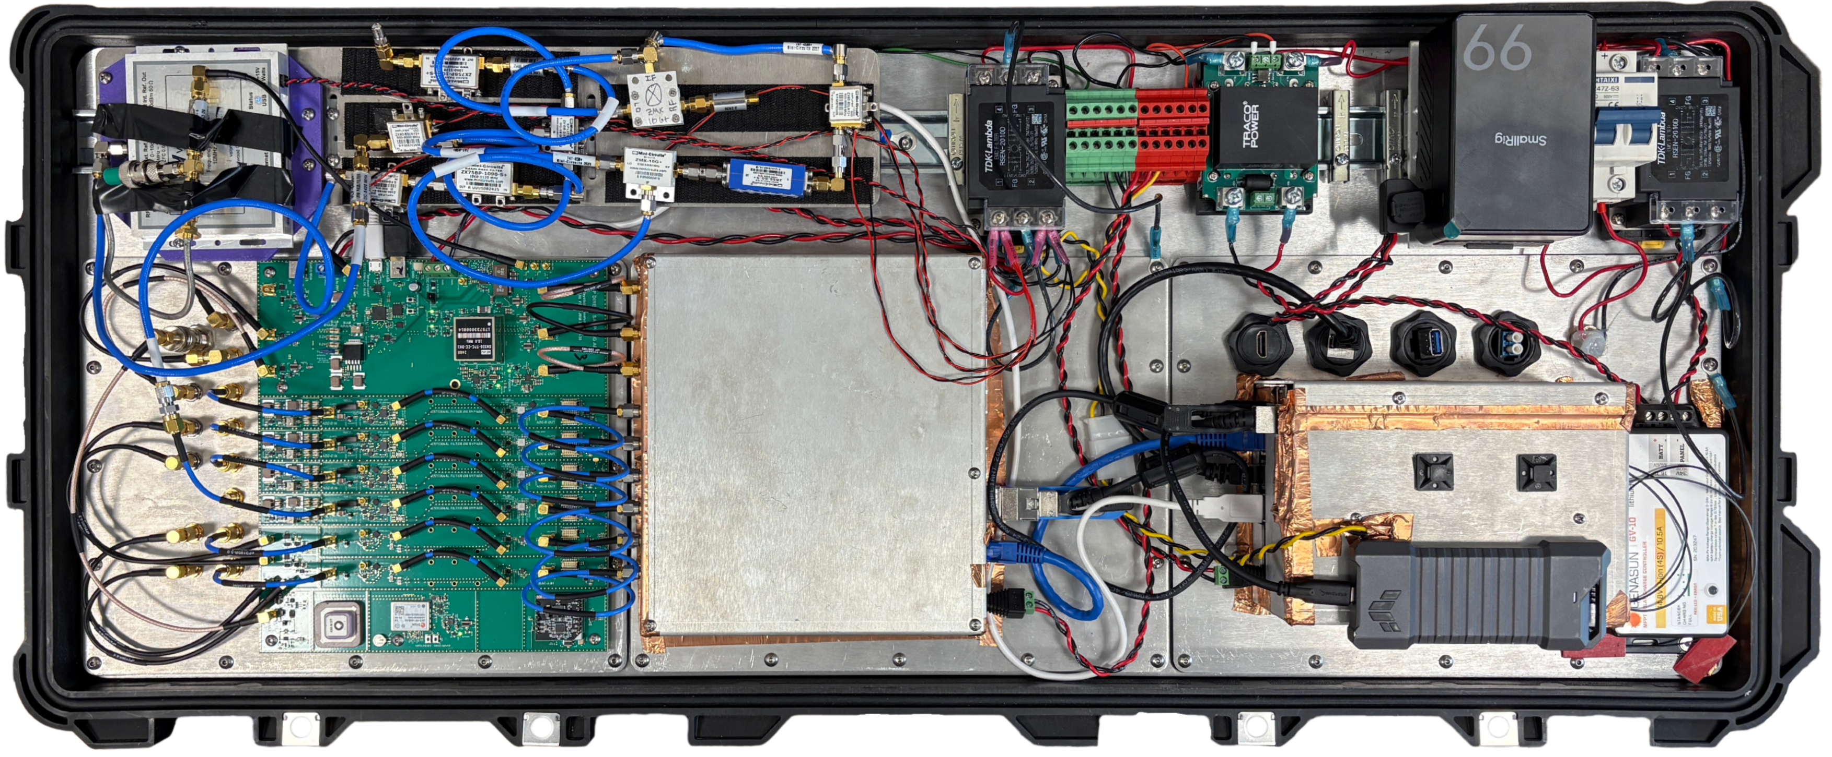
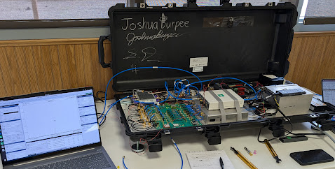
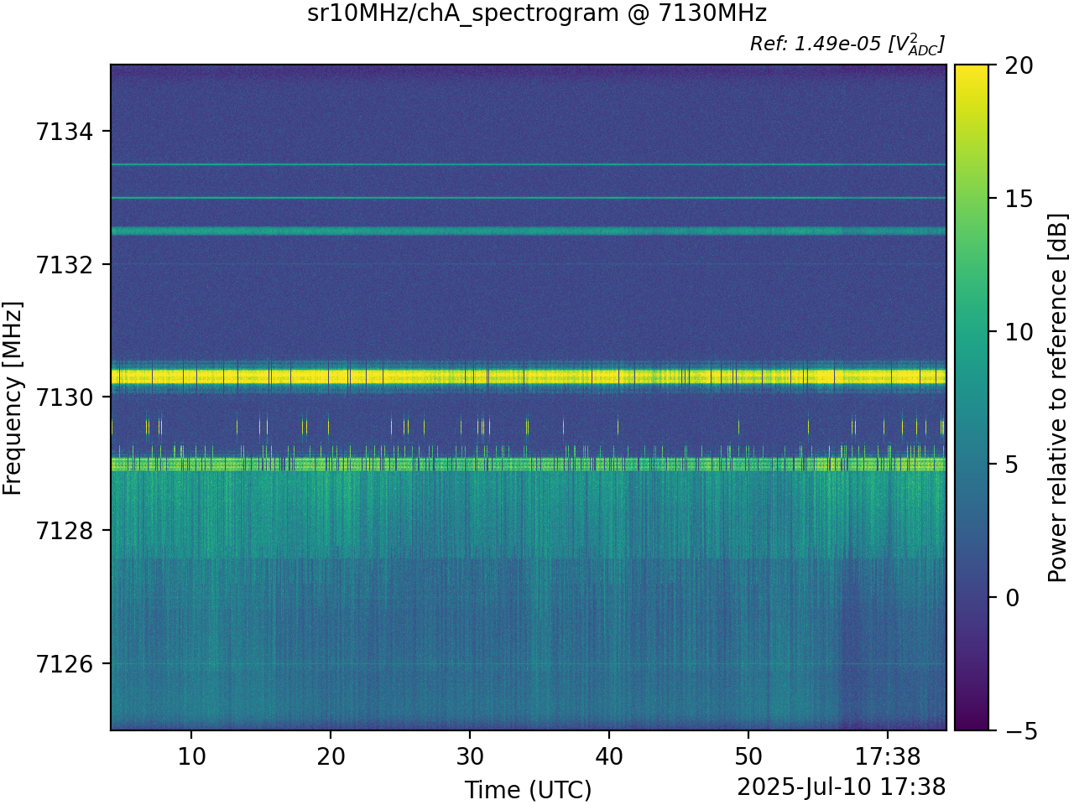
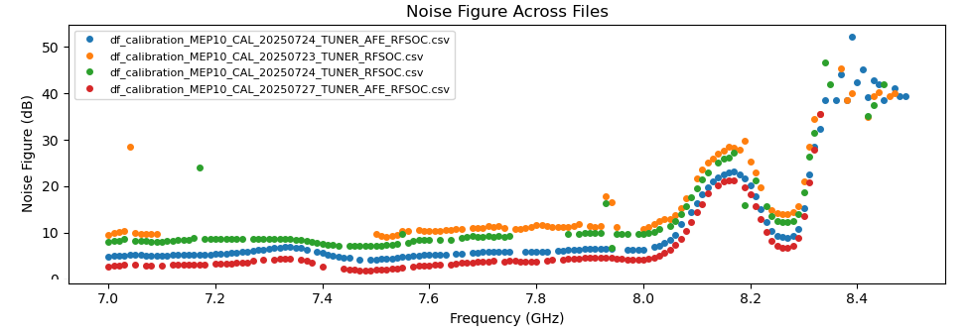
RF Spectrum Monitoring with the Mobile Experiment Platform
Alisa Yurevich^{1,4}, Ben Welchman^{2,4}, Allyson Sterling^{3,4}
Mentors: M. Knapp⁴, R. Volz⁴, F.Lind⁴, S.Thé⁴, J.Swoboda⁴, A. Pop Stefanija⁴
¹Tufts University, Medford, MA; ²Rice University, Houston, TX; ³Worcester Polytechnic Institute, Worcester, MA; ⁴MIT Haystack Observatory, Westford, MA
Flagship Project 1: Spectrum Awareness for Coexistence
VLA Field Deployment Overview
Flagship Project 1 of SpectrumX focuses on enabling coexistence between radio astronomy and 6G technologies.
Four stationary vehicles, each equipped with a receiving MEP, were positioned around the VLA site (Fig. 2). A fifth vehicle containing two MEPs, one transmitting and one receiving, transitioned between the locations (Fig. 3).
Although formal 6G specifications do not yet exist, the experimental team emulated a representative uplink on 5G NR standards within the 7.125 – 8.4GHz band (Fig 4).
To support this research, the Mobile Experiment Platform (MEP) was developed for real-time RF monitoring and deployed at NRAO's Very Large Array. (Fig 1).
Figure 2. Receiving configuration
The transmitter operated at 7.133 GHz center frequency, emulating 6G signals while stationary at positions 1 and 2, then during mobile operation along the highway route (Fig 3). All receiving MEPs continuously recorded the 7.133 GHz band (10 MHz bandwidth) throughout the experiment.
This platform is capable of multiple channel wideband transmit and receive. Each unit integrates a Jetson Orin NX, RFSoC 4x2, and a custom Analog Frontend/Mixer board.
Host software deployed via Ansible on Jetson uses Python scripts for NTP sync, RFSoC/tuner sweeps, and recorder control. A Docker data plane processes the RFSoC's UDP I/Q stream into Digital RF HDF5 files.
Figure 3. Transmitting configuration
Figure 4. Transmitted signal centered at 7.133GHz. The transmit signal is broadcast at 23dBm using an omnidirectional antenna.
Figure 1.
Mobile Experiment Platform
Hardware Overview
Software Architecture
Splitter
Mixer
Filter
Amplifier
DC/DC Converter
EMC Filter
Frequency Synthesizer
99W Battery
Figure 5. A MEP Unit setup for transmit at the VLA
RP2040
Circuit Breaker
4 RX Channels
Solar Charge Controller
2 TX Channels
GNSS Receiver
RFSoC 4x2 SDR
Jetson Orin NX
Experimental Results and Future Work
Autogenerated spectrograms are created during recording on receiver MEPs (Fig 6). To determine absolute power of received signals, calibration with a two-state noise diode is underway (Fig 7).
Correlated data taken by the VLA will be compared to receival MEP data and used to examine the impact of 6G wireless technology on the 7.125-8.5GHz band utilized by radio astronomy.
Figure 7. Noise Figure statistics of MEP 10 at CU Boulder, swept from 7-8.4GHz
Acknowledgments
This work has been supported in part by the National Science Foundation under the SpectrumX center award 2132700 and by the SWIFT program 2029670. Additionally, we would like to thank the staff at MIT Haystack Observatory, and members of the UW-Madison, Northwestern, and CU Boulder teams. Special thanks to Ali Abedi, Nick Rainville, and John Marino.
Figure 6. Spectrogram from receiving MEP at Location 2 (Fig 1).

